Slide 1

KultureHire Data Analytics Learnternship
Uderstanding Career Asperations of Gen Z

Slide 2
ROADMAP
1
2
3
Problem Statement Documentation
Data Collection for Project
Data Cleaning and Standardisation using Excel
4
5
6
7
Exploratory Data Analysis using Excel
Data Analysis using SQL
Executive Dashboard in Excel
Functional Dashboards in Power BI

Slide 3
Stage 1 : Problem Statement Documentation
1.Who?
Who are Gen Z? Who makes up Gen Z's racial diversity in the U.S.?
2. What?
What sectors are impacted by Generation Z? What are some things from the 90s that Gen Z doesn’t relate to?
3. When?
When did Gen Z emerge as a generation?
When is the U.S. workforce expected to experience the most significant worker shortage?

Slide 4
4. Where?
Where does Gen Z have a significant impact? Where is the Baby Boomer retirement impacting most?
5. Why?
Why do companies need to focus on ethics to attract Gen Z? Why are Baby Boomers retiring at a rapid pace?
6. How?
How can companies win the hearts of Gen Z?

Slide 5
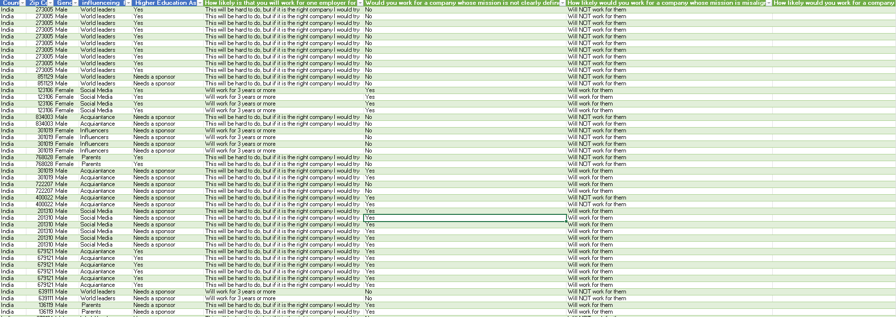
Stage 2 : Data Collection for Project

Slide 6
Stage 3: Data Cleaning and Standardisation using Excel

Slide 7
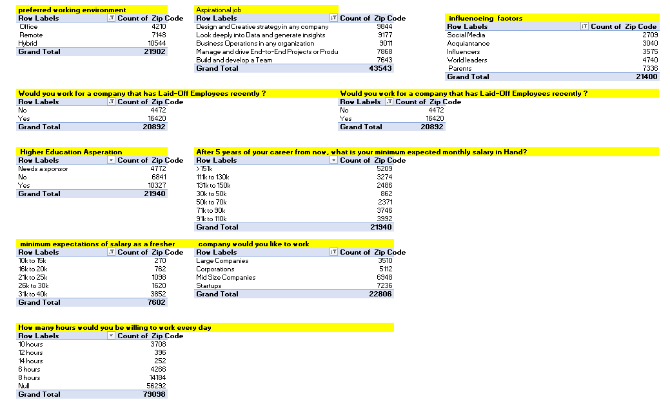
Stage 4:Exploratory Data Analysis using Excel

Slide 8
Stage 5: Data Analysis using SQL
1. What industries are Gen-Z most interested in pursuing careers in?
2. What are the top factors influencing Gen-Z’s career choices?
3. What is the desired work environment for Gen-Z? (e.g., remote, hybrid, in-office)
4. How do financial goals, such as salary and benefits, impact career aspirations among Gen-Z?
5. What role do personal values and social impact play in career choices for Gen-Z?

Slide 9
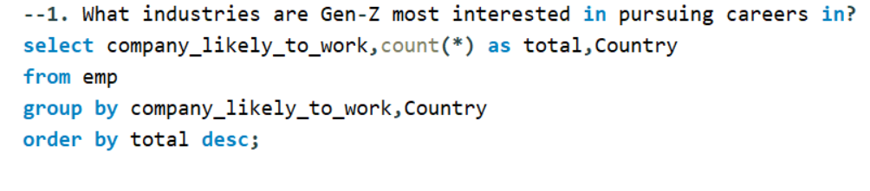
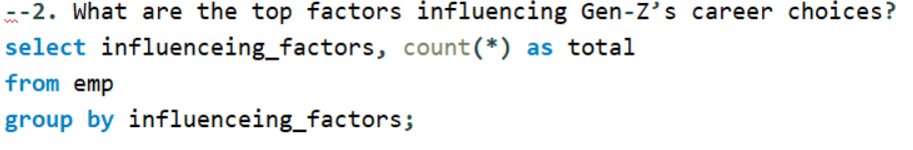
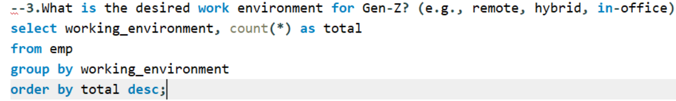

Slide 10
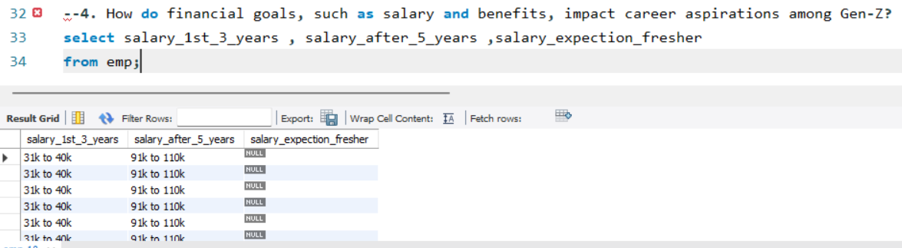
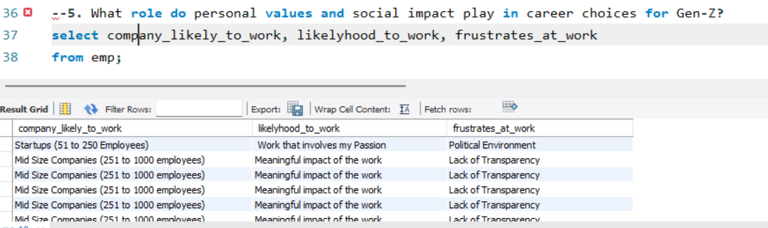

Slide 11
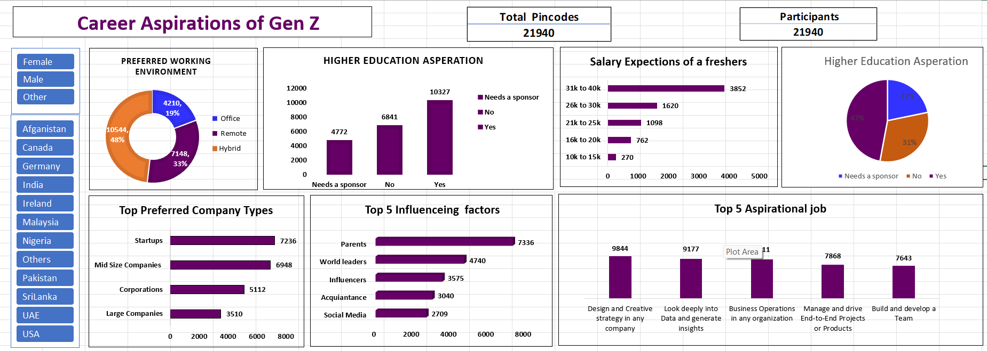
Stage 6 : Executive Dashboard in Excel

Slide 12
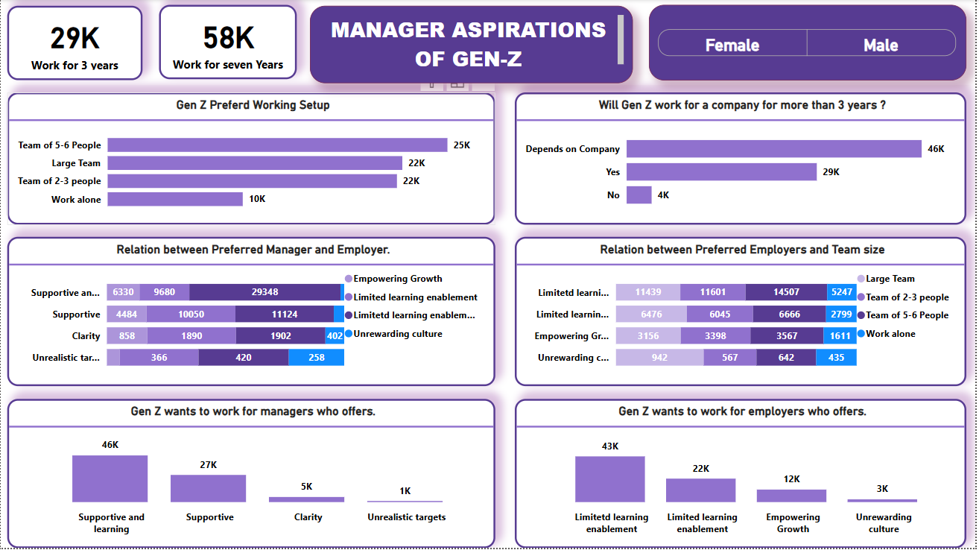
Stage 7:Functional Dashboards in Power BI

Slide 13
